Slide 1

ChronoSynk
Greggory Foust
CIT498
Fall 15

Slide 2
Overview
Another social media platform? Why?
  Focus is on getting together whether online or in person

Slide 3
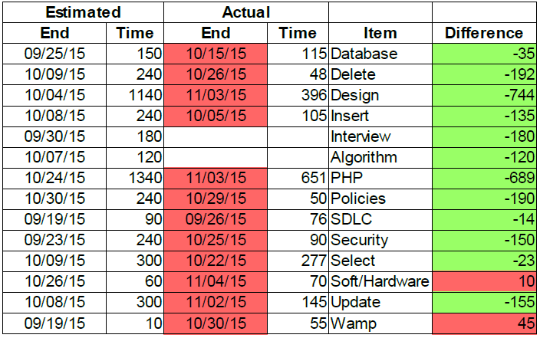
Work Completed
Dropping my time line
PHP – Like a well oiled machine
SQL – Rough around the edges
HTML and CSS – How do I <div>
Joins, Permissions, Emails, call_user_func_array(array($stmt, 'bind_param'), $a_params);
2373 Lines of code
50 hours of work
Research consisted of mostly PHP.net,
and stackoverflow.com witih some
w3schools.com and other various sites.

Slide 4
Work Completed
ChronoSynk
├───about
├───contact
├───faq
├───help
├───policies
│ ├───acceptableuse
│ ├───privacy
│ └───termsofuse
├───recovery
├───sessions
│ ├───edit
│ └───view
├───settings
└───user
└───friends
Register/Edit Profile/Password
Login/Logout
Admin Auto Logout
Create/Edit Session
Search Session
Join/Leave Session
Add/Cancel/Accept/Remove Friend
View recent friend activity
Post Comments
Contact Form
Password Reset
Data Validation
Character Escaping
Prepared Statements
Salting and Hashing
Auto Logout
Database Checks

Slide 5
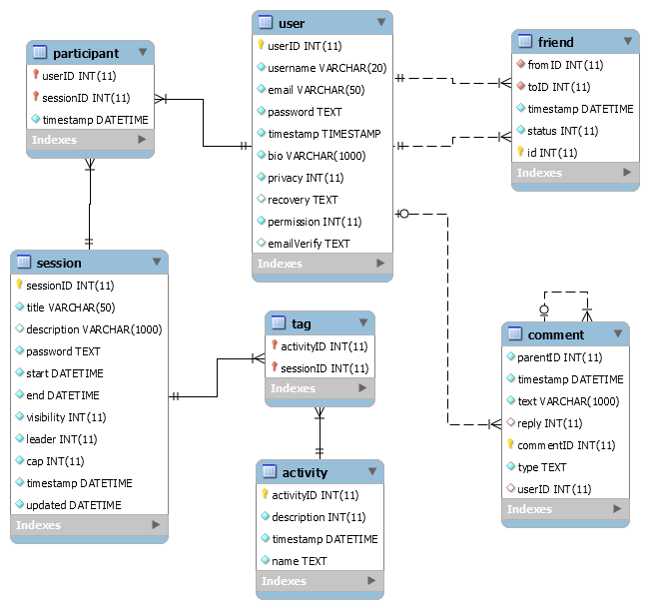
Work Completed

Slide 6
Learning Experience
Project management is hard and I don't like it
Planning is difficult but it helps in the end
Reaffirmed by opinion that I like coding

Slide 7
Demo
127.0.0.1/chronosynk

